Slide 2
CONTENTS
Block cipher modes of operation
Multiple Encrption
Double DES , Triple DES
RC4

Slide 3

Multiple Encryption
Given the potential vulnerability of DES to a brute-force attack, there has been considerable interest in finding an alternative.
One approach is to design a completely new algorithm, of which AES is a prime example.
Another alternative, which would preserve the existing investment in software and equipment, is to use multiple encryption with DES and multiple keys.

Slide 4
Double DES is a stepping stone between the original DES and more secure methods. Here's a quick rundown:
Double the Keys: It uses DES twice, but with two different keys (K1 and K2).
Encryption Chain: Plaintext is encrypted with K1, then that intermediate result is encrypted again with K2 for the final ciphertext.
Security Boost: This offers some improvement over DES with a perceived key size of 112 bits (actually closer to 56 bits due to a weakness).
Not the Best: Double DES is vulnerable to certain attacks and is not considered secure for modern needs.
Superseded: Triple DES (three passes of DES) and AES are stronger and more widely used encryption standards.

Slide 5
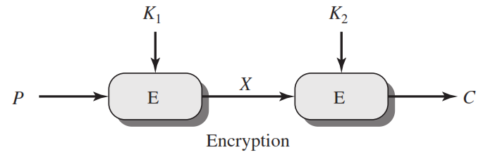
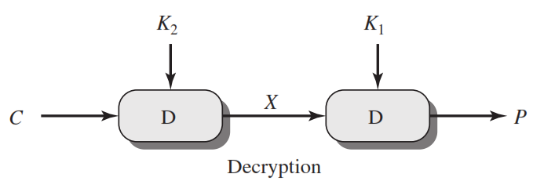
Double DES
C=E(K₂,E(K₁, P))
X = E(K₁, P) = D(K₂, C)
P=D(K₁,D(K₂, C))

Slide 6
Meet in the Middle Attack
This attack involves encryption from one end, decryption from the other and matching the results in the middle.
Suppose cryptanalyst knows P and corresponding C.
Now, the aim is to obtain the values of K1 and K2.

Slide 7
Meet in the Middle Attack Step-1
For all possible values (256) of key K1, the cryptanalyst would encrypt the P by performing E(K1,P).
The cryptanalyst would store output in a table.
Possible Keys
(Key = K1)
00
01
10
11
P
Table of Cipher Text
Encrypt
Cryptanalyst encryption operation

Slide 8
Meet in the Middle Attack Step-2
Cryptanalyst decrypt the known C with all possible values of K2.
In each case cryptanalyst will compare the resulting value with the all values in the table of ciphertext.
Possible Keys
(Key = K2)
00
01
10
11
Table of Cipher Text
C
Decrypt
For each result do a table look up
Cryptanalyst decryption operation

Slide 9
Triple DES
Triple DES (TDES) strengthens encryption by running the older DES algorithm three times with different keys on each data block.
This increases security compared to DES alone, with an effective key size of 112 or 168 bits depending on the key setup.
While more secure than DES, newer encryption standards like AES offer better security and speed.
Triple DES remains in use for legacy systems or situations requiring backwards compatibility . Overall, Triple DES was a security improvement but is not the most modern or efficient option today.

Slide 10
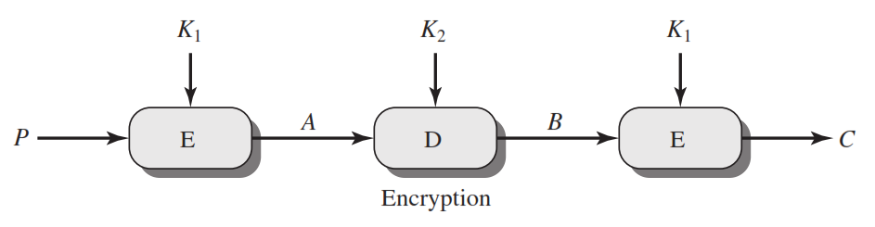
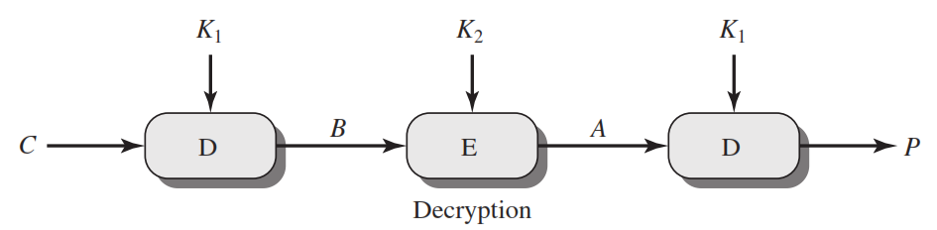
Triple DES
C=E(K₁,D(K₂, E(K₁,P)))
P=D(K₁,E(K₂, D(K₁,C)))

Slide 11
Block Cipher Modes of Operations
To apply a block cipher in a variety of applications, five "modes of operation" have been defined.
The five modes are intended to cover a wide variety of applications of encryption for which a block cipher could be used.
These modes are intended for use with any symmetric block cipher, including triple DES and AES.
Electronic Code Book (ECB)
Cipher Block Chaining (CBC)
Cipher Feedback (CFB)
Output Feedback (OFB)
Counter (CTR)

Slide 12
1. Electronic Code Book (ECB)
In ECB Mode Plaintext handled one block at a time and each block of plaintext is encrypted using the same key.
The term codebook is used because, for a given key, there is a unique ciphertext for every b-bit block of plaintext.

Slide 13
ECB Encryption & Decryption
64-bit
64-bit
K
K
…
K
Encrypt
Encrypt
Encrypt
64-bit
64-bit
C₁
C₂
C_{N}
C₁
C₂
C_{N}
64-bit
64-bit
K
K
…
K
Decrypt
Decrypt
Decrypt
64-bit
64-bit
P₁
P₂
P_{N}

Slide 14
Electronic Code Book ( Continue)
Strength: it’s simple.
Weakness:
Repetitive information contained in the plaintext may show in the ciphertext, if aligned with blocks.
If the message has repetitive elements with a period of repetition a multiple of b bits, then these elements can be identified by the analyst.
Typical application:
Secure transmission of short pieces of information (e.g. a temporary encryption key)

Slide 15
2. Cipher Block Chaining (CBC)
CBC is a technique in which the same plaintext block, if repeated, produces different ciphertext blocks.
In this scheme, the input to the encryption algorithm is the XOR of the current plaintext block and the preceding ciphertext block; the same key is used for each block.
To produce the first block of ciphertext, an initialization vector (IV) is XORed with the first block of plaintext.
On decryption, the IV is XORed with the output of the decryption algorithm to recover the first block of plaintext.

Slide 16
CBC - Encryption & Decryption
IV
C_{N-1}
K
K
…
K
Encrypt
Encrypt
Encrypt
C₁
C₂
C_{N}
C₁
C₂
C_{N}
K
K
…
K
Decrypt
Decrypt
Decrypt
IV
C_{N-1}
P₁
P₂
P_{N}

Slide 17
Cipher Block Chaining (CBC) – Continue…
Strength: because of the chaining mechanism of CBC, it is an appropriate mode for encrypting messages of length greater than b bits
Typical application:
General-purpose block oriented transmission
Authentication

Slide 18
3. Cipher Feedback Mode (CFB)
For AES, DES, or any block cipher, encryption is performed on a block of b bits. In DES, b = 64 and in AES, b = 128.
However, it is possible to convert a block cipher into a stream cipher, using cipher feedback (CFB) mode, output feedback (OFB) mode, and counter (CTR) mode.
A stream cipher eliminates the need to pad a message to be an integral number of blocks.

Slide 19
CFB Encryption
C_{N-1}
IV
Shift register b-s bits | s bits
Shift register b-s bits | s bits
K
K
K
Encrypt
Encrypt
Encrypt
Select s bits
Discard b-s bits
…
Select s bits
Discard b-s bits
Select s bits
Discard b-s bits
S bits
S bits
S bits
P₁
P₂
P_{N}
C₁
C₂
C_{N}
S bits
S bits
S bits

Slide 20
CFB Decryption
C_{N-1}
IV
Shift register b-s bits | s bits
Shift register b-s bits | s bits
K
K
K
Encrypt
Encrypt
Encrypt
Select s bits
Discard b-s bits
…
Select s bits
Discard b-s bits
Select s bits
Discard b-s bits
C₁
C₂
C_{N}
S bits
S bits
S bits
P₁
P₂
P_{N}
S bits
S bits
S bits

Slide 21
CFB Mode
The input to the encryption function is a b-bit shift register that is initially set to some initialization vector (IV).
The leftmost (most significant) s bits of the output of the encryption function are XORed with the first segment of plaintext P1 to produce the first unit of ciphertext C1 , which is then transmitted.
In addition, the contents of the shift register are shifted left by s bits, and C1 is placed in the rightmost (least significant) s bits of the shift register.
For decryption, the same scheme is used, except that the received ciphertext unit is XORed with the output of the encryption function to produce the plaintext unit.

Slide 22
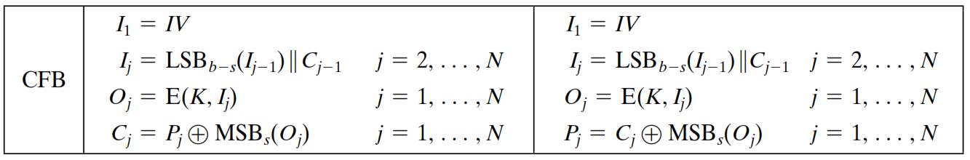
CFB Mode – Cont…

Slide 23
4. Output Feedback Mode (OFB)
The output feedback (OFB) mode is similar in structure to that of CFB.
For OFB, the output of the encryption function is fed back to become the input for encrypting the next block of plaintext.
In CFB, the output of the XOR unit is fed back to become input for encrypting the next block.
The other difference is that the OFB mode operates on full blocks of plaintext and ciphertext, whereas CFB operates on an s-bit subset.
Nonce: A time-varying value that has at most a negligible chance of repeating, for example, a random value that is generated anew for each use, a timestamp, a sequence number, or some combination of these.

Slide 24
OFB Encryption
Nonce
K
K
…
K
Encrypt
Encrypt
Encrypt
P₁
P₂
P_{N}
C₁
C₂
C_{N}

Slide 25
OFB Decryption
Nonce
K
K
…
K
Encrypt
Encrypt
Encrypt
C₁
C₂
C_{N}
P₁
P₂
P_{N}

Slide 26
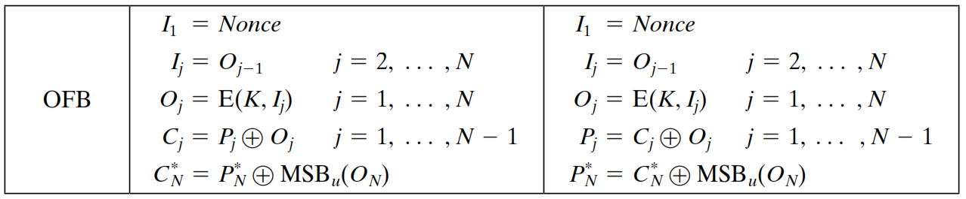
OFB Mode
Each bit in the ciphertext is independent of the previous bit or bits.
This avoids error propagation
Pre-compute of forward cipher is possible

Slide 27
5. Counter Mode (CTR)
Counter (CTR) mode has increased recently with applications to ATM (asynchronous transfer mode) network security and IP sec (IP security).
A counter equal to the plaintext block size is used.
The counter value must be different for each plaintext block that is encrypted.
Typically, the counter is initialized to some value and then incremented by 1 for each subsequent block

Slide 28
CTR Encryption
Counter 1
Counter 2
Counter N
K
K
…
K
Encrypt
Encrypt
Encrypt
P₁
P₂
P_{N}
C₁
C₂
C_{N}

Slide 29
CTR Decryption
Counter 1
Counter 2
Counter N
K
K
…
K
Encrypt
Encrypt
Encrypt
C₁
C₂
C_{N}
P₁
P₂
P_{N}

Slide 30
Advantages of the CTR Mode
Strengths:
Needs only the encryption algorithm
Random access to encrypted data blocks
blocks can be processed (encrypted or decrypted) in parallel
Simple; fast encryption/decryption
Counter must be
Must be unknown and unpredictable
pseudo-randomness in the key stream is a goal

Slide 31
Summary of all modes
Operation Mode | Description | Type of Result
ECB | Each n-bit block is encrypted independently with same key | Block Cipher
CBC | Same as ECB, but each block is XORed with previous cipher text | Block Cipher
CFB | Each s-bit block is XORed with s-bit key which is part of previous cipher text | Stream Cipher
OFB | Same as CFB, but the shift register is updated by the previous s-bit key | Stream Cipher
CTR | Same as OFB, but a counter is used instead of nonce | Stream Cipher

Slide 32
What is RC4 Encryption?
RC4 means Rivest Cipher 4 invented by Ron Rivest in 1987 for RSA Security. It is a Stream Ciphers. Stream Ciphers operate on a stream of data byte by byte. RC4 stream cipher is one of the most widely used stream ciphers because of its simplicity and speed of operation. It is a variable key-size stream cipher with byte-oriented operations. It uses either 64 bit or 128-bit key sizes. It is generally used in applications such as Secure Socket Layer (SSL), Transport Layer Security (TSL), and also used in IEEE 802.11 wireless LAN std.

Slide 33
Why Encryption Is Important?
Unauthorized data access can be prevented by encryption. If we perform encryption then third parties can not have access to data which we share or receive. The encryption is done by using a secret key, or we can say that by using a public key and private key. Both sender and receiver are having their public key and private key through which encryption of plain text and decryption of ciphertext is performed.

Slide 34
Types of RC4
There are various types of RC4 such as Spritz, RC4A, VMPC, and RC4A.
SPRITZ: Spritz can be used to build a cryptographic hash function, a deterministic random bit generator (DRBG), n an encryption algorithm that supports authenticated encryption with associated data (AEAD).
RC4A: Souraduyti Paul and Bart Preneel have proposed an RC4 variant, which they call RC4A, which is stronger than RC4.
VMPC: VMPC is another variant of RC4 which stands for Variably Modified Permutation Composition.
RC4A+: RC4A+ is a modified version of RC4 with a more complex three-phase key schedule which takes about three times as long as RC4 and a more complex output function which performs four additional lookups in the S array for each byte output, taking approximately 1.7 times as long as basic RC4.

Slide 35
Algorithm
The algorithm operates on a user-selected variable-length key(K) of 1 to 256 bytes (8 to 2048 bits), typically between 5 and 16 bytes. To generate a 256-byte state vector S, the master key is used. The first step is the array initialization. It is a character array of size 256 i.e. S[256]. After that, for every element of the array, we initialize S[i] to i.
Code for array initialization: Char S[256]; int i; for(i=0;i<256;i++) S[i] = i The array will look like - S[] = {0, 1, 2, 3, ------, 254, 255}
After this, we will run the KSA algorithm-
KSA is going to use the secret key to scramble this array. KSA is a simple loop, in which we are having two variable i and j. We are using these variables to rearrange the array. Rearranging the array is done by using a secret key.

Slide 36
Algorithm
Code for KSA (Key Scheduling Algorithm ) : int i, j=0; for(i=0;i<256;i++) { j=( j + S[i] + T[i]) mod 256; Swap(S[i], S[j]); }
KSA has been scrambled, S[256] array is used to generate the PRGA(Pseudo Random Generation Algorithm). This is the actual Keystream.
Code for PRGA ( Pseudo Random Generation Algorithm ): i=j=0; while(true) { i = ( i + 1 ) mod 256; j = ( j + S[i] ) mod 256; Swap( S[i], S[j] ); t = ( S[i] + S[j] ) mod 256 ; k = S[t]; }
This is the next step of scrambling.

Slide 37
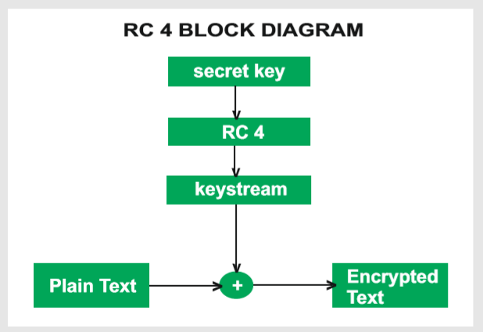
RC4 Block Diagram

Slide 38
Working of RC4
Encryption Procedure:
The user inputs a plain text file and a secret key.
The encryption engine then generates the keystream by using KSA and PRGA Algorithm.
This keystream is now XOR with the plain text, this XORing is done byte by byte to produce the encrypted text.
The encrypted text is then sent to the intended receiver, the intended receiver will then decrypted the text and after decryption, the receiver will get the original plain text.
Decryption Procedure:
Decryption is achieved by doing the same byte-wise X-OR operation on the Ciphertext.
Example: Let A be the plain text and B be the keystream (A xor B) xor B = A

Slide 39
Advantages and Disadvantages
Advantages:
RC4 stream ciphers are simple to use.
The speed of operation in RC4 is fast as compared to other ciphers.
RC4 stream ciphers are strong in coding and easy to implement.
RC4 stream ciphers do not require more memory.
RC4 stream ciphers are implemented on large streams of data.
Disadvantages:
If RC4 is not used with strong MAC then encryption is vulnerable to a bit-flipping attack.
RC4 stream ciphers do not provide authentication.
RC4 algorithm requires additional analysis before including new systems.
RC4 stream ciphers cannot be implemented on small streams of data.
RC4 fails to discard the beginning of output keystream or fails to use non-random or related keys for the algorithm.

